Slide 1


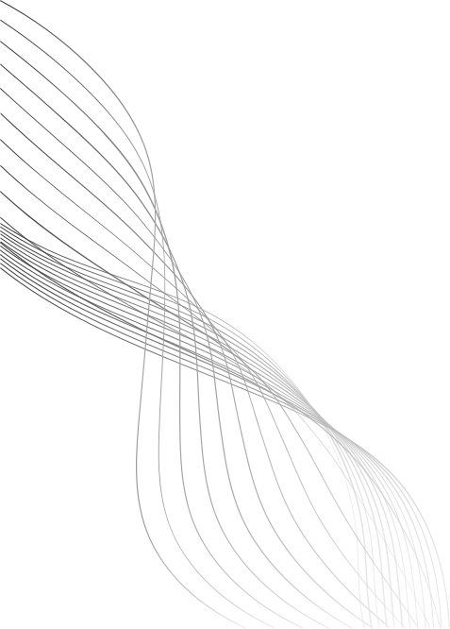
DIGITAL PORTFOLIO
STUDENT NAME: A.MARWA
REGISTER NO: 24134131802522011
NMID: asanm41341324214011/
884992C6960475096A048155A9FF5AAC
DEPARTMENT: BSC(COMPUTER SCIENCE )
COLLEGE: DEEN COLLEGE OF ARTS AND SCIENCE
NIDUR -KADUVANGUDI
Notes:
REGISTER NO:24134130

Slide 2
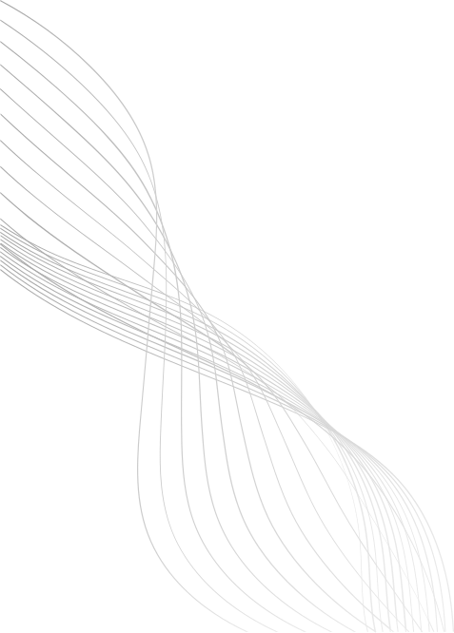
STUDENT
DIGITAL
PORTFOLIO

Slide 3
AGENDA
PROBLEM STATEMENT
PROJECT OVERVIEW
END USERS
TOOLS &TECHNOLOGIES
PORTFOLIO DESIGN & LAYOUT
FEATURES & FUNCTIONALITY
RESULT&SCREENSHOTS
CONCULATION
GITHUB LINK

Slide 4
PROBLEM STATEMENT
Many students do not have a proper online platform to present their profile, skills, and achievements, making it harder to stand out in academics or job applications.

Slide 5
PROJECT OVERVIEW
A modern and responsive digital portfolio website was designed using web technologies to highlight personal details, academic background, and technical skills.

Slide 6
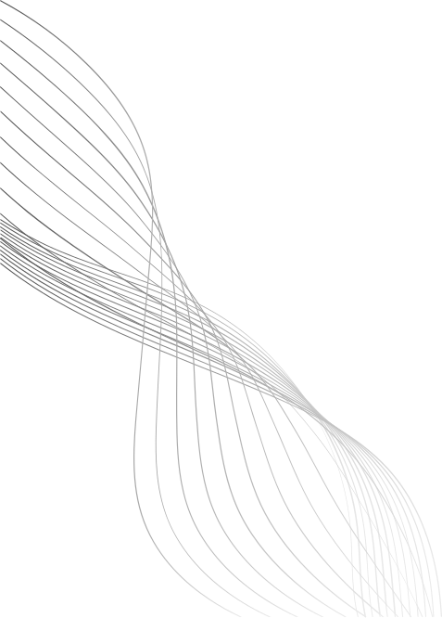
END USERS
Students - to present their academic and technical work.
Employers/Interviewers - to quickly understand the candidate's capabilities.
Faculty/Peers - to evaluate and share feedback.

Slide 7
TOOLS & TECHNOLOGIES
HTML - Provides structure to the portfolio.
CSS (Style.css) - Adds design, colors, and layout.
Responsive CSS (style2.css) – Adjusts the layout for tablets and mobiles.
JavaScript - Adds interactivity like mobile navigation toggle.

Slide 8
PORTFOLIO DESIGN & LAYOUT
Website sections: Home, About Me,
Skills/Services, Portfolio, Contact, and Footer.
Attractive design with images, headings, and interactive navigation.
,

Slide 9
FEATURES & FUNCTIONALITY
Works on desktop, tablet, and mobile devices.
Interactive hamburger menu.
Organized service cards and portfolio showcase.
Contact form for communication.

Slide 10
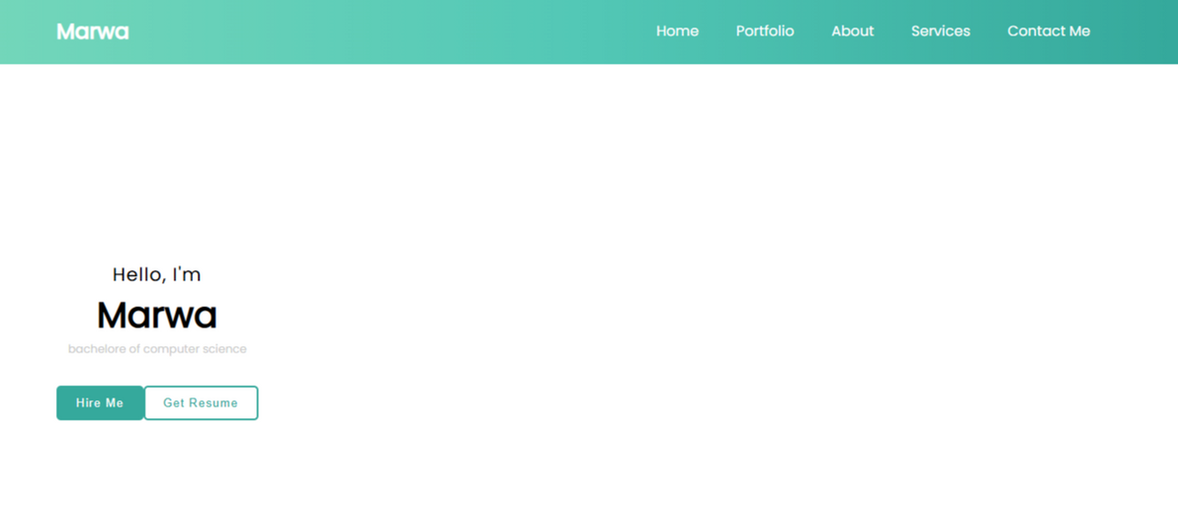
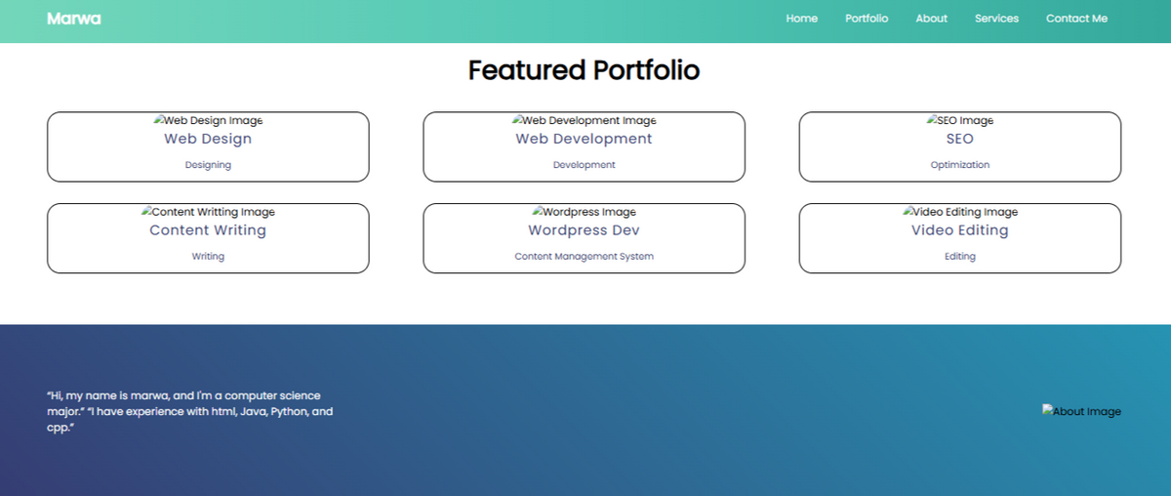
RESULTS & SCREENSHOTS

Slide 11
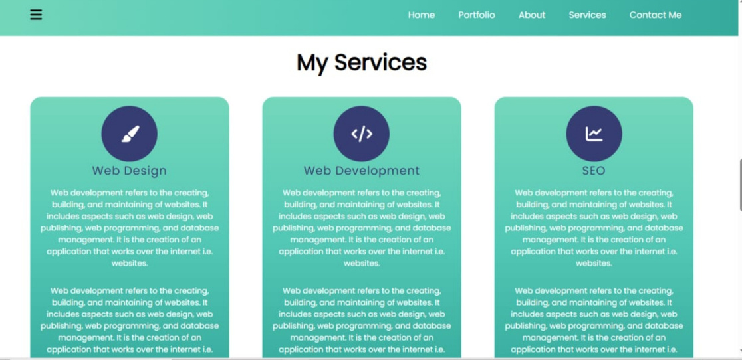
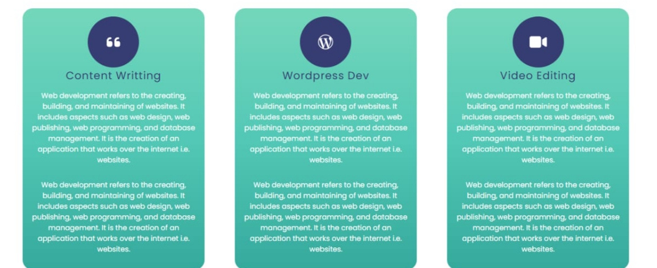
RESULTS & SCREENSHOTS

Slide 12
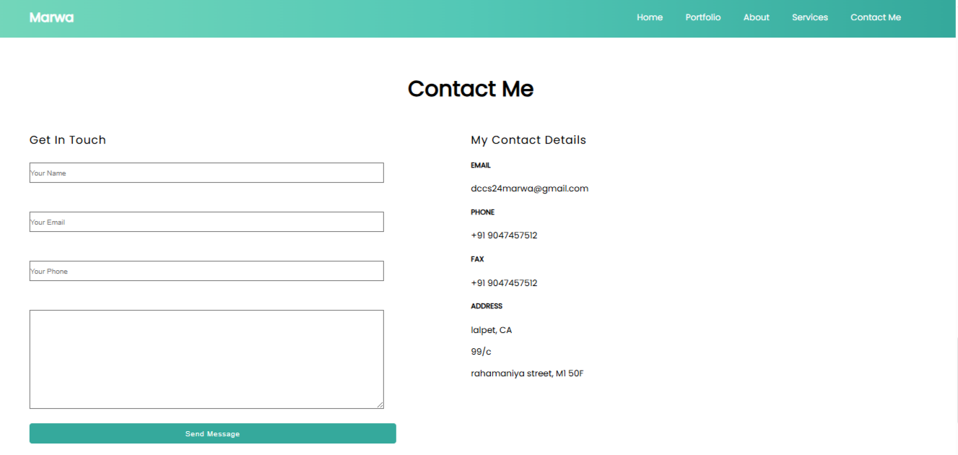
RESULTS & SCREENSHOTS

Slide 13
CONCLUSION
This portfolio serves as a digital resume, helping students demonstrate their skills and connect with recruiters or institutions effectively.

Slide 14
GITHUB LINK
https://github.com/dccs24marwa/Marwa-TNSDC-FWD-DP.git

